Slide 1
Unit 9: Searching

Slide 2
CONTENTS
Introduction to Search Technique
Sequential search
Binary search
Tree search
General search tree
Hashing: Hash function and hash tables, Collision resolution technique, Efficiency comparisons of different search technique.

Slide 3
Searching
Searching is a process of finding an element within the list of elements stored in any order or randomly. Searching is divided into two categories
Linear and
Binary search.

Slide 4
Sequential Search:
In linear/sequential search, access each element of an array one by one sequentially and see whether it is desired element or not. A search will be unsuccessful if all the elements are accessed and the desired element is not found.
In brief, Simply search for the given element left to right and return the index of the element, if found. Otherwise return “Not Found”.
Algorithm:
LinearSearch(A, n,key)
{
for(i=0;i<n;i++)
{
if(A[i] == key)
return i;
}return -1;//-1 indicates unsuccessful search
}
Analysis:
Time complexity = O(n)

Slide 5
Binary Search:
This search technique searches the given item in minimum possible comparisons. To do this binary search, first we need to sort the array elements.
The logic behind this technique is given below:
First find the middle element of the array.
compare the middle element with an item.
There are three cases:
If it is a desired element then search is successful
If it is less than desired item then search only the first half of the array.
If it is greater than the desired element, search in the second half of the array.
Repeat the same process until element is found or exhausts in the search area.
In this algorithm every time we are reducing the search area.

Slide 6
Running example:
Take input array a[] = {2 , 5 , 7, 9 ,18, 45 ,53, 59, 67, 72, 88, 95, 101, 104}

Slide 7
Example

Slide 8
Binary Search Algorithm
BinarySearch(A,l,r, key)
{
if(l= = r) //only one element
{
if(key = = A[l])
return l+1; //index starts from 0
else
return 0;
}
else
{
m = (l + r) /2 ; //integer division
if(key = = A[m]
return m+1;
else if (key < A[m])
return BinarySearch(l, m-1, key) ;
else
return BinarySearch(m+1, r, key) ;
}
}

Slide 9
Efficiency:
From the above algorithm we can say that the running time of the algorithm is
T(n) = T(n/2) + O(1)= O(logn)
In the best case output is obtained at one run i.e. O(1) time if the key is at middle.
In the worst case the output is at the end of the array so running time is O(logn) time
In the average case also running time is O(logn).

Slide 10
Tree Search
A tree structure is a hierarchy of linked nodes where each node represents a particular state. Nodes have none, one or more child nodes.
A solution is a path from the “root” node to the goal node. The tree search algorithm differs by the order in which nodes are traversed.
Blind search algorithm
Involves Breadth-first and Depth-first algorithm. Blind search is not suitable for the complex problems as the large search space makes them impractical given time and memory constrains.
Best-first search algorithm
It uses a heuristic functions to determine the order in which the nodes are traversed, giving preference to states that are judged to be most likely to reach the required goal

Slide 11
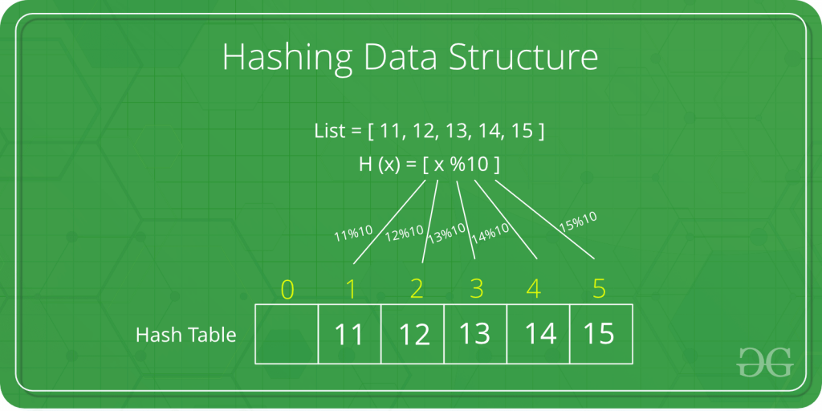
Hashing:
It is an efficient searching technique in which key is placed in direct accessible address for rapid search. Hashing provides the direct access of records from the file no matter where the record is in the file. Due to which it reduces the unnecessary comparisons. This technique uses a hashing function say h which maps the key with the corresponding key address or location.
A function that transforms a key into a table index is called a hash function.
Let a hash function H(x) maps the value x at the index x%10 in an Array. For example if the list of values is [11,12,13,14,15] it will be stored at positions {1,2,3,4,5} in the array or Hash table respectively.

Slide 12
Hash collision:
If two or more than two records trying to insert in a single index of a hash table then such a situation is called hash collision.
Some popular methods for minimizing collision are:
Linear probing
Quadratic probing
Rehashing
Chaining
Hashing using buckets etc
But here we need only first two methods for minimizing collision

Slide 13
Linear probing:
A hash-table in which a collision is resolved by putting the item in the next empty place within the occupied array space.
It starts with a location where the collision occurred and does a sequential search through a hash table for the desired empty location.
Hence this method searches in straight line, and it is therefore called linear probing.
Disadvantage:
Clustering problem

Slide 14
Example: Insert keys {89, 18, 49, 58, 69} with the hash function h(x)=x mod 10 using linear probing.
when x=89:
h(89)=89%10=9
insert key 89 in hash-table in location 9
when x=18:
h(18)=18%10=8
insert key 18 in hash-table in location 8
when x=49:
h(49)=49%10=9 (Collision occur)
so insert key 49 in hash-table in next possible vacant location of 9 is 0
when x=58:
h(58)=58%10=8 (Collision occur)
insert key 58 in hash-table in next possible vacant location of 8 is 1
(since 9, 0 already contains values).
when x=69:
h(89)=69%10=9 (Collision occur)
insert key 69 in hash-table in next possible vacant location of 9 is 2
(since 0, 1 already contains values).

Slide 15
Fig Hash-table for above keys using linear probing

Slide 16
Quadratic Probing:
Quadratic probing is a collision resolution method that eliminates the primary clustering problem take place in a linear probing.
When collision occur then the quadratic probing works as follows:
(Hash value + 1²)% table size
if there is again collision then there exist rehashing.
(hash value + 2²)%table size
if there is again collision then there exist rehashing.
(hash value + 3²)% table size
In general in i collision
hi(x)=(hash value +i²)%size of the table

Slide 17
Insert keys {89, 18, 49, 58, 69} with the hash-table size 10 using quadratic probing.
when x=89:
h(89)=89%10=9
insert key 89 in hash-table in location 9
when x=18:
h(18)=18%10=8
insert key 18 in hash-table in location 8
when x=49:
h(49)=49%10=9 (Collision occur)
so use following hash function,
h1(49)=(49 + 1)%10=0
hence insert key 49 in hash-table in location 0
when x=58:
h(58)=58%10=8 (Collision occur)
so use following hash function,
h1(58)=(58 + 1)%10=9
again collision occur use again the following hash function ,
h2(58)=(58+ 2²)%10=2
insert key 58 in hash-table in location 2
when x=69
h(89)=69%10=9 (Collision occur)
so use following hash function,
h1(69)=(69 + 1)%10=0
again collision occur use again the following hash function ,
h2(69)=(69+ 2²)%10=3
insert key 69 in hash-table in location 3

Slide 18
fig: Hash table for above keys using quadratic probing

